Slide 1
KNN & Collaborative filtering
Asheesh
Bhamati

Slide 2
KNN
Parameters K-
Higher K Values- Underfit
Lower K Values- Overfit
Optimal K –Values Beyond which your Accuracies are decreasing
K-Values should be odd numbers for a binary classifier

Slide 3
Condense KNN
This technique is used to make the KNN classifier faster
Here we take a small subset out of train data which classifies the data well.
Algorithm:
Take a sample from Train Ti and put it in a smaller subset M
Try to classify the next sample in train using the samples in Subset M
If the train data is classified correctly then repeat the step b until all the train samples are correctly classified
If any of the train sample is misclassified then drop that sample into subset M and start the classification again from start until all the samples are rightly classified.
Finally the subset M is the set of samples which classify the train data correctly and possibly are the sample which signify decision boundaries

Slide 4
KNN Applications
One of the popular imputation Technique
Detects the outliers in a high dimensional space
To predict on samples which have unseen class or new classes of test

Slide 5
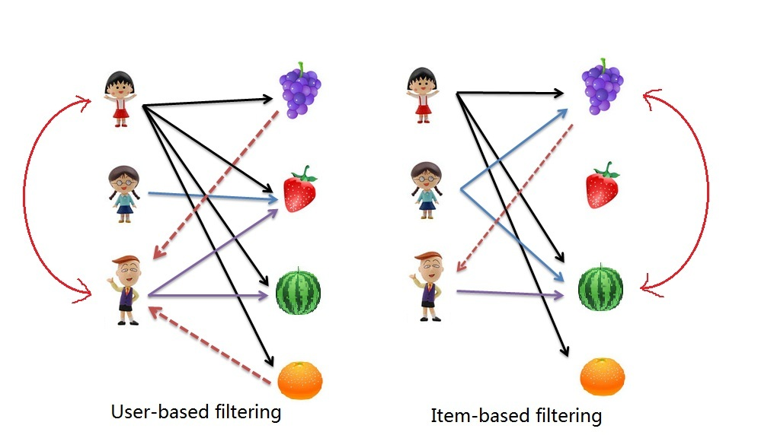
Collaborative Filtering
User Based
Item Based

Slide 6
Collaborative Filtering Intuition
Problem statement:
Sajna wants to know if she can see conjuring 2 in her study break
Item Based CF:
Havea rating matrix with the user in it with conjuring 2 as part of the items.
This is Movie Vs Users Rating matrix
Find out the nearest neighbours to conjuring 2 (The Haunting,AmmityVilli etc based on Rating matrix)
Take the weighted average of user’s rating on similar movies and compute what could be the rating for conjuring 2.
Computed Rating = (S13*U1I3+ S17*U1I7)/(S13+S17)
The above formula is for 2 nearest neighbors,
Sij- Centered Cosine similarity between items Item I and Item J
UIJ- User I rating for item J

Slide 7
Collaborative Filtering Intuition
Problem statement:
Sajna wants to know if she can see conjuring 2 in her study break
Item Based CF:
Havea rating matrix with the user in it with conjuring 2 as part of the items.
This is Movie Vs Users Rating matrix(Mean normalized matrix)
Find out the nearest neighbours to conjuring 2 (The Haunting,AmmityVilli etc based on Rating matrix)
Take the weighted average of user’s rating on similar movies and compute what could be the rating for conjuring 2.
Computed Rating = (S13*U1I3+ S17*U1I7)/(S13+S17)
The above formula is for 2 nearest neighbors,
Sij- Centered Cosine similarity between items Item I and Item J
UIJ- User I rating for item J
5. If Computed Rating happens to be more than Sajna’s average rating then we tend to recommend conjuring 2 to her

Slide 8
Collaborative Filtering Pros And Cons
Pros:
Takes into consideration the personalized recommendations
(Finds similar users or items to recommend)
Cons
If the user has not rated nearest neighbors rating cannot be computed for Item-User combination.

Slide 9
Thank You

